Slide 1

National Traffic System (NTS)
An Introduction
Greg Szpunar, N2GS,
NTS Official Relay Station,
NTS Digital Relay Station
Dave Struebel, WB2FTX,
Section Traffic Manager
ARRL Northern New Jersey Section
Eastern Area Digital Coordinator, NTSD
Updated June 2012

Slide 2
National Traffic System (NTS)
Messaging Basics
Outline
What is the National Traffic System?
Advantages of NTS Messaging
NTS Hierarchy and modes
The ARRL Radiogram Form
ARL Abbreviated Texts
How to Deliver an NTS Message
NTS Digital
VHF Digital BBS demo
Local NTS Contacts & Nets
Additional Resources

Slide 3
What is the National Traffic System (NTS)?
The “RELAY” in American Radio Relay League (ARRL)
Started in 1915 as the formal ARRL system to relay messages around the country
Transmit & Receive Modes: Voice, CW, Digital
NTS and Amateur Radio Emergency Services (ARES)
Requirements to join: Any level Ham license & interest
ARRL Field Organization Appointments: Official Relay Station (ORS), Digital Relay Station (DRS) & Section Traffic Manager (STM).

Slide 4
Advantages of NTS Messaging
Wireless! Send them from anywhere.
Use a little HT or a big base station
Standard Format
Accountability
NTS Nets meet daily
Speed (digipeater vs. email)
When all else fails…
Fun, good practice & helpful!

Slide 5
NTS Hierarchy and Modes
US and Canada organized into Area, Region, and Local Nets
  3 Areas
  12 Regions
Traffic Flow:
TCC
Area Nets
Area Nets
HF Phone, CW, Digital
Region Nets
Region Nets
Section/ Local Nets
VHF/UHF Phone, HF Phone, CW, Digital
Section / Local Nets

Slide 6

NTS Areas
PAN
EAN
CAN

Slide 7
States/Provinces, Regions and Areas
State | Region | Area
CT, ME, MA, NH, RI, VE | 1RN | EAN
NJ, NY | 2RN | EAN
DE, DC, MD, PA | 3RN | EAN
FL, GA, NC, PR, SC, VI, VA | 4RN | EAN
MI, OH, WV | 8RN | EAN
LB, NB, NF, NS, ON, PE, PQ | 2RN | EAN
AL, AR, LA, MS, OK, TN, TX | 5RN | CAN
IL, IN, KY, WI | 9RN | CAN
IA, KS, MB, MN, MO, NE, ND, NWT, SK, SD | 10RN | CAN
CA, GU, HI, NV | 6RN | PAN
AK, AB, BC, ID, MT, NWT, OR, WA | 7RN | PAN
AZ, CO, NM, UT, WY | 12RN | PAN

Slide 8
2RN Sections and Divisions
State | Division | Sections
New Jersey | Hudson | NNJ
New Jersey | Atlantic | SNJ
New York | Hudson | ENY, NYCLI (NLI)
New York | Atlantic | NNY, WNY

Slide 9
Message Format
The ARRL Radiogram

Slide 10
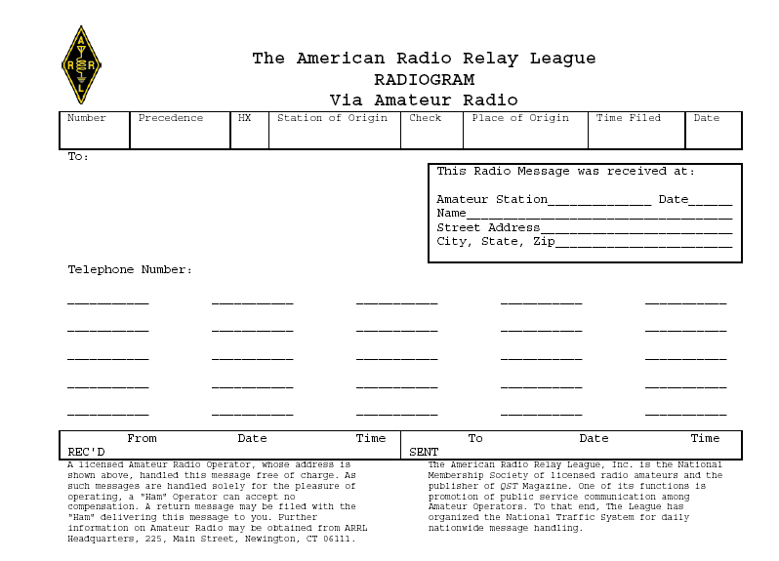
704 R C N2GS 14 CHESTER NJ 1830 JUL 2
JOE SMITH KC2XXY
1234 SECOND ST
SUMMIT NJ 07901
650-123-4567
THIS IS THE ARRL RADIOGRAM FORM XRAY DETAIL TO FOLLOW XRAY HAVE FUN 73
GREG SZPUNAR N2GS
austin AK2US 7/2/03 2112 EDT

Slide 11
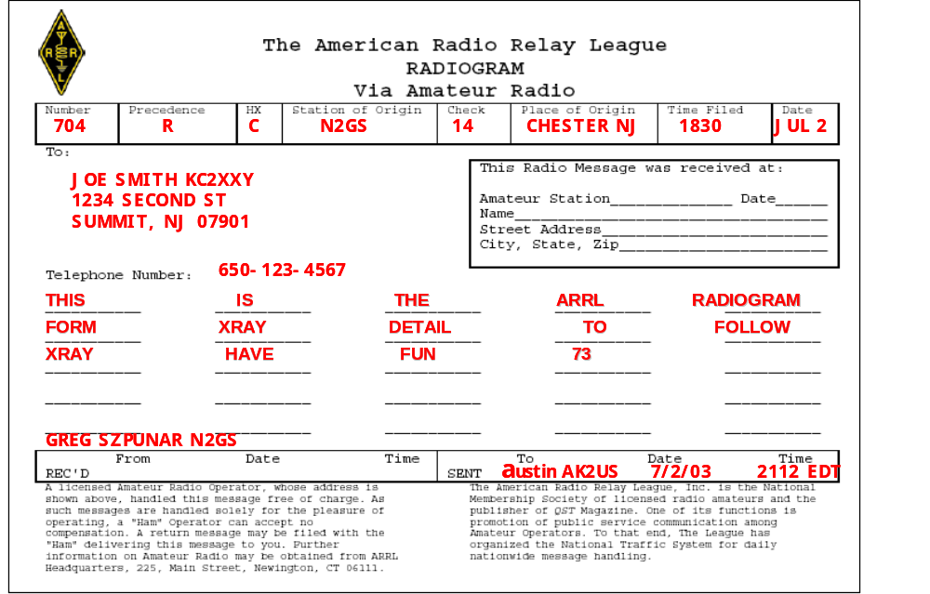
ARRL Radiogram Form
Preamble: Message number, precedence, HX (optional handling code), station of origin, check (text word count), place of origin, time filed (optional), and date.
Addressee: Name, call sign (if a ham),
full street address, city, 2-letter state abbreviation, zip code (very important) & telephone (be sure to include area code).
This Radio Message was received at:
Station identification and location.
Text: 25 words maximum, 5 per line;
Use the word “xray” for a period (.) and “query” for a question mark (?). Last word
in salutation (e.g., “73”, “Love”, etc.)
Signature: (Write-in above REC’D block) Name & call sign of person who wrote the message – include full phone number if not a Ham or if new to NTS.
REC’D & SENT: Record the names and call sign of the person you rec’d the message from and/or sent/forwarded the message to, along with the date & time (EST/EDT or Z).

Slide 12
Radiogram Form Detail (1 of 6)
704 R C N2GS 14 CHESTER NJ 1830 JUL 2
Number
  Assigned by the message originator
  No standard way of numbering messages
  Consecutive (1, 2, 3..., starting over at the new year or monthly)
  Order by month & number (507 = 7th you originated in May;
  11244 = 244th message you originated in November
Precedence (Emergency, P, W, or R)
  Emergency (life or death urgency in a declared emergency) always spelled out
  P = Priority (official traffic in a declared emergency)
  W = Health & Welfare (used only in a declared emergency)
  R = Routine (everything else – most frequently used)

Slide 13
Radiogram Form Detail (2 of 6)
704 R C N2GS 14 CHESTER NJ 1830 JUL 2
(Optional) HX or Handling Code – A, B, C, D, E, F or G
  Collect landline delivery authorized within ___ miles of addressee or unlimited if blank
  (A150 = collect call authorized w/in 150 miles; A = collect call authorized regardless of miles)
  Cancel message if not delivered within ___ hours of filing time & service originating station
  (B72 = cancel if not delivered within 72 hrs and send message to originator to notify them)
  Confirmation of delivery requested by originating station (“TOD YOUR 1014 JULY 4 1330 PST XRAY 73” or if issues “ARL SIXTY SEVEN 1014 PHONE 650 555 1212 INCORRECT NO REPLACEMENT FOUND SENT RADIOGRAM INSTEAD XRAY 73”
  Report your identity & time/date rec’d message plus time/date delivered or sent to another
  Delivering station to get reply from addressee and send to originator as a new message
  Hold delivery until ___ (numbered day of month) – great for birthday or anniversary messages
  (F14 = deliver on 14th of the month; F1 = deliver on the 1st of month after date filed)
  Delivery by mail or toll call not required, service originating station (often ignored).

Slide 14
Radiogram Form Detail (3 of 6)
704 R C N2GS 14 CHESTER NJ 1830 JUL 2
Station of Origin: Call sign of station who put the message into NTS format; If N2GS prepares message 1207 for a fellow ham, then puts it onto an NTS packet BBS for relay to Vermont, the originator is... N2GS. If WB2W prepares message 23 for his non-ham neighbor then gives it to N2GS to relay to any NTS net, the originator is... WB2W.
Check: The word count in body text only (do not count the address or signature); precede with “ARL” if any of the ARL numbered texts are used (e.g., ARL 7).
Place of Origin: The city & state where the message was written.
(Optional) Time Filed: This is not used much... 24-hr format & time zone
Date: Month (non-numeric – abbreviated) & day number message was created e.g., Sep 21).

Slide 15
Radiogram Form Detail (4 of 6)
JOE SMITH KC2XXY
1234 SECOND ST
SUMMIT NJ 07901
650-123-4567
To:
Name, call sign (if going to a ham), street address or P.O. Box, city, state (abbreviated) & zip code. Note: Digital and packet NTS messages are routed via zip code.
Telephone Number:
Be sure to include the area code and double-check the number!!!
This Radio Message was received at:
Your station identification, date received, and your location. More received-from detail will go in the “REC’D” block after body text and signature.

Slide 16
Radiogram Form Detail (5 of 6)
THIS IS THE ARRL RADIOGRAM
FORM XRAY DETAIL TO FOLLOW
XRAY HAVE FUN 73
GREG SZPUNAR N2GS
Text: 25 words maximum, 5 per line; Use “xray” for a period (.) and “query” for a question mark (?).
Signature: There is no “Signature” field, just write-in below text; Name & call sign of author – include phone number if not a ham or if not known on an NTS net.

Slide 17
Radiogram Form Detail (6 of 6)
Austin AK2US 7/2/03 2112 EDT
REC’D: Call sign from whom you received the message and date & time of receipt. Time may be either your local time (EST/EDT) or Zulu time. Make sure date agrees with time (Zulu is 5 hours ahead of EST – can cause date to roll forward).
SENT: Call sign you sent or passed the message to, or to whom you delivered it, with date & time. Also good to note delivery method for your own reference (i.e., via phone or left on Tom’s voicemail). Always leave your call back number if message was left on voicemail!

Slide 18
ARL Numbered Texts
Purpose & How Counted
ARL Numbered Texts replace common phrases in message body text (i.e., Happy Birthday, Greetings by amateur radio, etc.)
Use of ARL texts reduce total message word count – faster and more consistent transmission of text
Translated before delivery of message to addressee
ARL text numbers are always spelled-out in words
(i.e., ARL SEVEN or ARL FORTY SIX)
Message word count (check) is written as “ARL #” (e.g., ARL 4 or ARL 15) to alert operators that message includes at least one ARL numbered text.

Slide 19
ARL Numbered Texts (Examples)
ARL FORTY SIX = Greetings on your birthday and best wishes for many more to come.
ARL FORTY SEVEN = Your message ______ to ______ delivered _______ _______UTC
ARL FIFTY = Greetings by amateur radio.
ARL FIFTY ONE = Greetings by amateur radio. This message is sent as a free public service by ham radio operators at _______. Am having a wonderful time.
ARL SIXTY SEVEN = Your message number _____ undeliverable because of ______. Please advise.

Slide 20
How to Deliver an NTS Message
Preferred delivery is via telephone.
Okay to leave on voicemail or answering machine IF you are comfortable you reached the right person.
Radiogram postcard if cannot reach by phone.
Service originating station to inform if cannot deliver or if they requested confirmation.

Slide 21
Record Keeping & Reporting (PSHR)
Use a log sheet to keep track of your messages
Use a PSHR log sheet to tally monthly points for Public Service Honor Roll
Report message count (originated, sent, received
& delivered) to STM monthly
Report PSHR totals to STM STM = Dave Struebel WB2FTX wb2ftx@arrl.net)

Slide 22
NTS Digital
Dave Struebel WB2FTX
Eastern Area Digital Coordinator- NTSD
Section Traffic Manager- NNJ

Slide 23
Advantages of NTS Digital
Available 24/7, 365 days a year
Error Free
Frequency, Time, Propagation Agile
Faster
Able to respond and adapt quicker to urgent needs like disaster messages
Multiple redundant routing paths
NTSD exists at and incorporates all levels of traditional NTS from TCC, through Area, Region, Section and Local .

Slide 24
Not to Replace Traditional NTS
Complementary system
Trained operators always needed for origination and delivery of messages

Slide 25
Digital Mode History
RTTY- After WWII, 5 level Baudot code, mechanical teletypewriters, paper tape storage.
Noisy
Signals subject to selective fading and drop out errors.
Equipment relatively available via surplus route
Some units as big as a sub-compact car
AMTOR- Still 5 bit code, but with limited error correction.
Burst mode-requires fast transmit/receive switching

Slide 26
FCC Authorizes ASCII- late 70's
7 bit code- with some error detection
HF Packet- 300 baud, Long bursts, error correcting but needing large signal to noise ratio to properly decode
Net result- Many retries, slows down transfer rate

Slide 27
First integrated system- APLINK
(Amtor/Packet Link)
Bulletin Board System incorporating Amtor on HF with transfer of data to VHF Packet
Highly successful but suffers from selective fading
With 5 bit encoding- only capital letters.
No compression
No file transfer

Slide 28
Classic Winlink- Win 3.11/Win 95
Win 98, 2000, XP
Modules for AMTOR, CLOVER, PACTOR 1,2, and 3
Along with VHF Packet
Scanner function allowing multiple auto calls varying in time, frequency, mode, based upon propagation.
Multiple forwarding paths
With SCS proprietary modem for Pactor 2 and 3 allows automatic frequency control, automatic power level control
Compressed and binary transfer of data

Slide 29
Winlink 2000 (aka WL2K)
Developed by Winlink Classic Programmers in late 1990's
Uses Pactor 1, 2, and 3, VHF/UHF Packet Sound Care Winmor module, Telnet
Forwarding via Internet; Radio all the way via NTSD if infrastructure fails
Radio-email and Integration of NTS NTSD and ARES
Chapter 6 Methods and Practices Guideline (MPG)
http://wx4j.com/MPG6_NTSD_RADIOEMAIL.htm

Slide 30
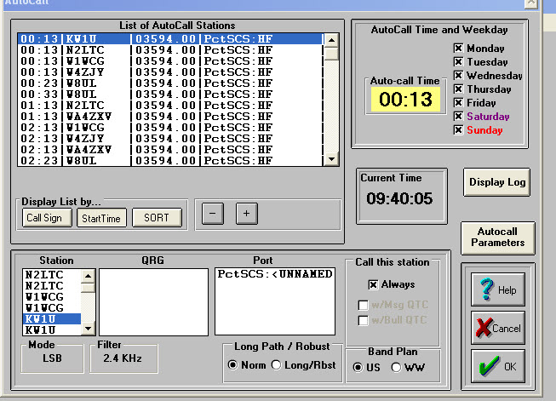
Autocall

Slide 31
NTSD and Pactor
HF NTSD Operates almost exclusively in the automatic control sub-bands
    3.585 - 3.600 MHz
    7.100 - 7.105 MHz
    10.140 - 10.150 MHz
    14.095 - 14.0995 MHz
    14.1005 - 14.1120 MHz
Using Pactor 1, 2, and Pactor 3.
  Pactor 2 and 3 are proprietary modes.
All pactor connects start out at Pactor 1 and then shift up to higher speed if the equipment at both ends is compatible.
Bandwidth for Pactor 1 and 2 is 500 Hz. pactor 3 will expand its bandwidth up to 2.4 KHz at highest speeds.

Slide 32
Eastern Area MBOs
KW1U 1RN Edgartown, MA
W1WCG 1RN North Haven, CT
W2SFD 2RN Glenville, NY
WB2FTX 2RN Butler, NJ EADC
W3JY 3RN Malvern, PA
WX4J 4RN Switzerland, FL
WA4ZXV 4RN Norcross, GA
W4DNA 4RN Goldsboro, NC
W8UL 8RN Reynoldsburg, OH
VE3GT ECN Renfrew, ON
VA3PM ECN Brampton, ON

Slide 33
Central and Pacific Area Hubs
KB0OFD Missouri
W5KAV Washington

Slide 34
Winlink 3.0 Components
Message Manager -Forwarding file
User Manager
Event Log
PCTSCS - HF Pactor module
PKT VHF- VHF Packet Module
Scanner- scanning, busy detector, event scheduling and rescheduling

Slide 35
Typical Forwarding File
NTSAK K4WWV W8UL KW1U
NTSAL W5KAV K4WWV W8UL KW1U W1WCG
NTSAB W5KAV K4WWV W8UL KW1U W1WCG
NTSAZ W5KAV K4WWV W8UL KW1U W1WCG
NTSAR W5KAV K4WWV W8UL KW1U
NTSB* W5KAV K4WWV W8UL KW1U
NTSCA W5KAV K4WWV W8UL
NTSCO W5KAV K4WWV W8UL

Slide 36
WB2FTX NTSD Station
HF
Kenwood TS-450S
SCS PTC-IIUSB Modem
MFJ 9913 Autotuner
B&W Folded Dipole
Computer- old Pentium 150 Mhz- Win 98 SE
Classic Winlink 3.0
Kantronics KPC-3 plus for packet port
VHF
FBB 7.00i BBS Software
Pentium 100 Mhz running DOS 6.22
1 Paccomm Tiny 2 TNC
Flexnet
Icom IC-38A, 25 watts
4 el 220 Mhz beam pointed at WA2SNA

Slide 37
NTS Digital Demonstration

Slide 38
Local Digital Traffic
Receipt and Origination via WB2FTX-4 PBBS
WB2FTX-4 accessible via WA2SNA (Ramapo Mtn), via NJ Flexnet System
SNJ partially served by NJ2AR-4 and KC2QVT-4
Node Name | Location | Frequency (MHz)
WA2SNA | Ramapo Mountain, Oakland, NJ | 145.01
WB2SNN | Sayreville, NJ | 145.51
N2QAE | Schooley’s Mountain, W Morris Co | 145.51
W2LI | Murray Hill, NJ | 145.05
W2LV | Kittatinny Mountain, W Sussex Co | 149.91
KC2QVT | Burlington Co, NJ | 145.09
W2GSA | Monmouth Co, NJ | 145.05
NJ2AR | Ocean Co, NJ | 145.03

Slide 39
Local NTS Digital
Basic equipment requirements
  2M rig
  TNC capable of 1200 baud VHF Packet
  Terminal Program
  OR
  Soundcard interface and software capable of emulating Packet
  Computer

Slide 40
Outpost Packet Message Manager
Outpost is a Windows-based packet message client that lets you send and receive packet messages with almost any Amateur Radio Bulletin Board System (BBS) or TNC Personal Mail Box.
Hides the complexity of the native packet environment and shorten the learning curve
Provide an MS Windows-based packet messaging client
Automate the packet message handling environment
Create a program that behaves like your email client that you have at work or home…
…create, send, receive, read, delete, reply to, or forward messages
Automates the origination and formatting of NTS messages.
Focus on the message not the medium
Freeware: http://www.outpostpm.org/

Slide 41
2RN Nets
Open to all HAMs
Liaisons to/from NJ and NY
Liaisons to EAN
Frequency (MHz) | Time | Mode
3.925 | 1:45 PM | SSB
3.925 | 4:35 PM | SSB
3.925 | 6:30 PM | SSB
3.576 | 7:45 PM | CW
3.576 | 9:30 PM | CW

Slide 42
NNJ/SNJ Section Nets
Open to all HAMs
Frequency (MHz) | Time | Name | Mode
3.544 | 10:00 AM | NJ Morning (WE) | CW
3.950 | 6:00 PM, 9AM (SU) | NJPN | SSB
3.547 | 6:30 PM | NJ Slow Net | CW
3.544 | 7:00 PM | NJ Net/Early | CW
3.544 | 10:00 PM | NJ Net/Late | CW

Slide 43
NNJ Local Nets
Open to all Hams with or without traffic handling experience.
A great place to start and to learn first hand.
Name | Time | Frequency (MHz) | Repeater | Comment
NJVN/E | 7:30 PM | 146.895 (PL 151.4) | WS2Q/ WB2FTX | Echolink via WB2FTX-R
CJTN | 8:00 PM | 146.760 (PL 156.7) 443.200 (PL 141.3) | K2GE | Echolink via K2GE-R
UCTN | 10:00 PM | Various 147.255 (PL 141.3) 449.975 (PL 141.3) | W2NJR/ WA2JWR/ W2LI | Echolink via W2NJR-R and WA2JWR-R
NJVN/L | 10:30 PM | 146.700 (PL 141.3) | W2PQG | Echolink planned

Slide 44
Additional Resources
ARRL Net Directory – Excellent NTS reference with net listings by state ($5 from ARRL). Online version is accessible free at the ARRL web site (www.arrl.org).
Public Service Communication Manual – Detailed reference on NTS message handling ($1 from ARRL), also available on ARRL web site.
Morris County NJ Amateur Radio Volunteers website – see NTS section:
  http://www.qsl.net/mcarv/nts.htm
K2UL website – Dan was the Section Traffic Manager for SNJ and has a great website.
http://www.qsl.net/k2ul/resource.htm

Slide 45
Acknowlegements
Pinkney Foster, KG6ILA, Section Traffic Manager ARRL Santa Clara Valley Section kg6ila@arrl.net whose presentation “National Traffic System (NTS)
Messaging Basics” inspired the message handling components of this presentation.
Jim Oberhofer, KN6PE, author of Outpost Packet Message Manager, and the resulting description included in this presentation.

Slide 46
Questions?

